Slide 1
SIEM Workflow
Module 9

Slide 2
Module Objectives
Upon completion of this module, you will be able to:
Drill into and out of various data views to go from a high level overview summary of an environment to specific details for an event of interest.
Pivot on event data into network flows and vice versa.
Collect additional data such as whois lookups, rule vulnerability information, and revers DNS looks to investigate an incident.
Create a case, alarm, or watchlist from event or network flows.
Create a event forwarding action for a specific subset of events.

Slide 3

Module Topics
SIEM Workflows and Views
Example Investigation
Case Management
Event Forwarding
Watchlists

Slide 4
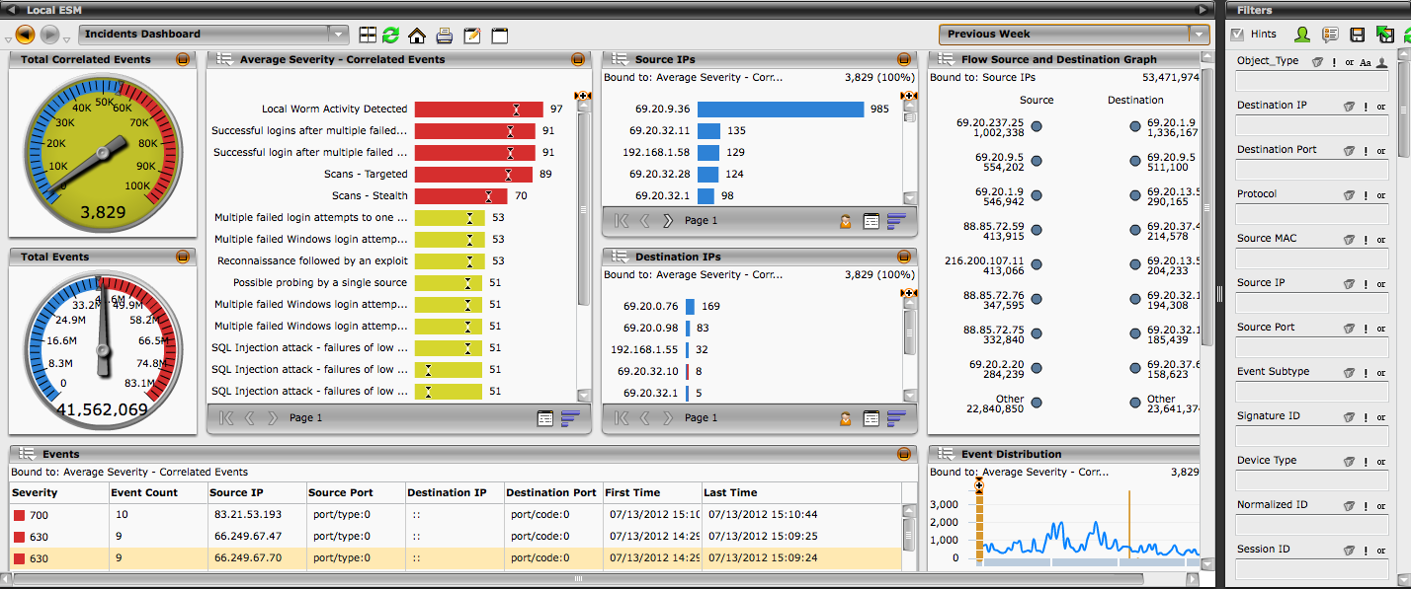
McAfee ESMI
The McAfee ESMI Desktop acts as the command center for all devices under its scope
Notes:
The McAfee ESMI is the front end for managing the ESM and all of its devices, providing the following major functions:
• Device configuration for both the Nitro IPS and its embedded firewall component, the Receiver and its data sources, the ADM and its virtual devices, distributed ESMs, the ELM and its data sources, and the DEM and its database servers
• Management, reporting, and analysis of event and flow data gathered from a Nitro IPS or Receiver device(s), as well as event data gathered from a DEM, Distributed ESM, ELM, or ADM
• Notification and logging based on user-specified conditions
• Retrieval of new signatures and software updates
• Tracking of device activity and status

Slide 5
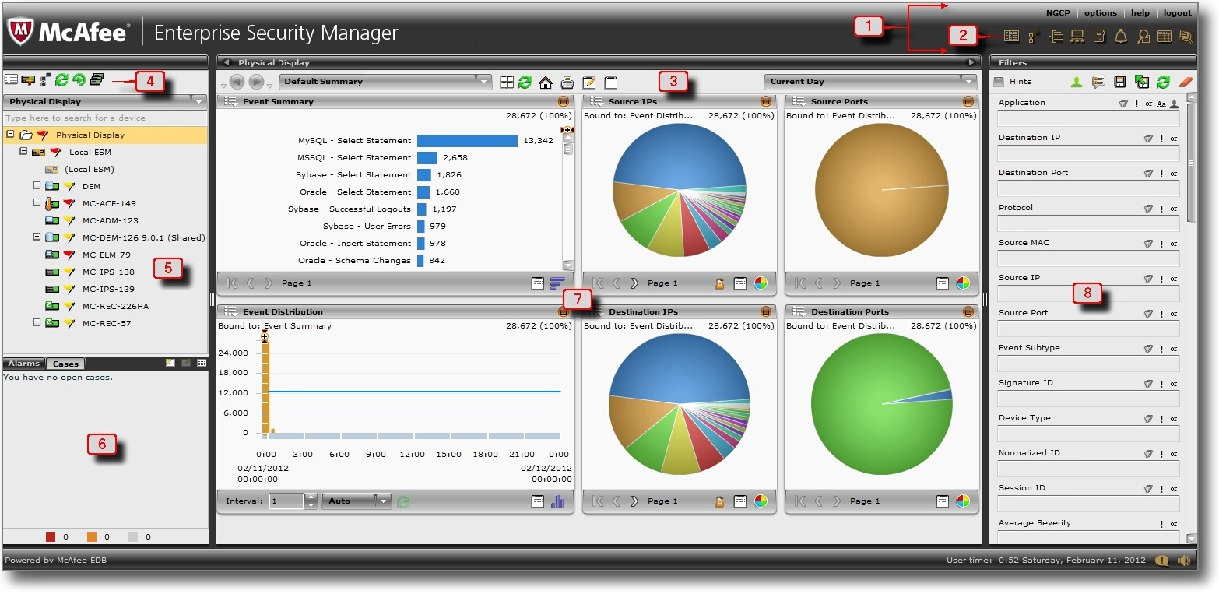
ESMI Desktop
ESMI Navigation Bar
Quick Launch Icons
Views Toolbar
Actions Toolbar
ESMI System Navigation Tree
Case Management Pane and Alarms Management Pane
ESMI Views Pane
ESMI Filters Pane

Slide 6
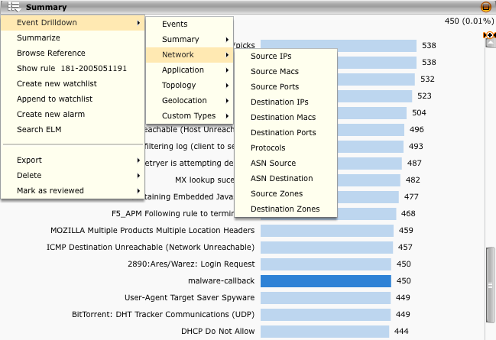
Event Drilldown
Most components have a menu in the upper left corner which allows you to pivot or drill down on the data in a variety of different fashions.
Based on the data in the window you are viewing, you may be able to drill down on events, flows, or assets.
Event Drilldown allows you to execute another event view using selections made in the current view as filters.
For an analyst this seamless capability provides a powerful event investigation methodology allowing them to quickly zoom in from a 10,000ft overview to the specific event details at ground level.

Slide 7
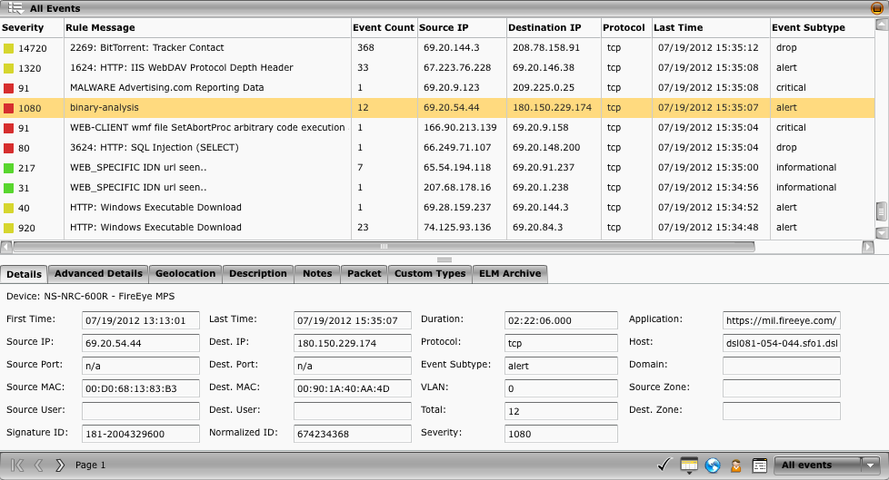
Event Analysis
When an analyst needs the specific event details this view provides them with easy to navigate tabs and one click access for marking the event as reviewed, creating and assigning a case, and performing reverse DNS lookups for IPs.
Notes:
This is the lowest viewable level within the McAfee SIEM and in most investigation workflows will be the resulting view of a drill down when investigating a specific event from or to a specific resource.

Slide 8
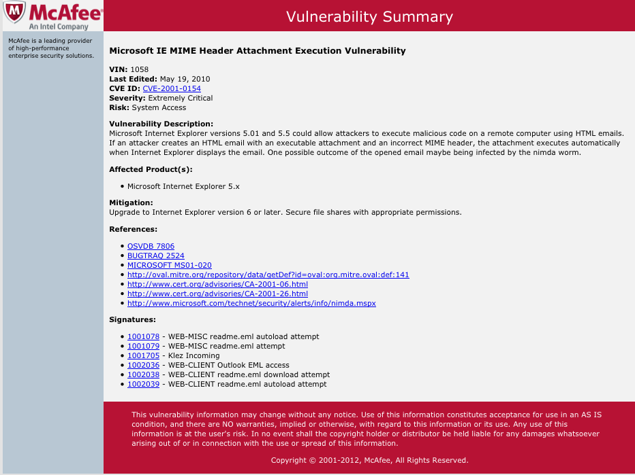
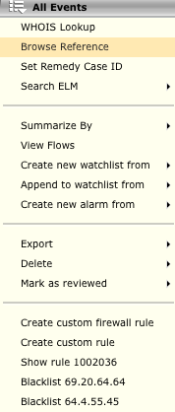
Event Analysis – Browse Reference
The Browse Reference option opens a web browser and connects to McAfee's online signature database, providing information about the signature for the selected rule.
Notes:
This is a useful feature when an analyst would like to gain additional information regarding an event or the vulnerability associated with an event.

Slide 9
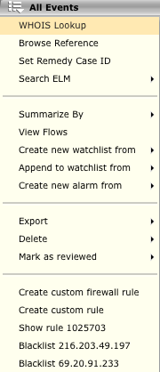
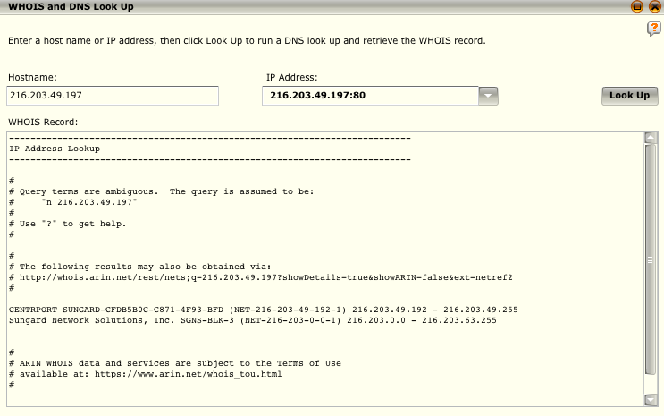
Event Analysis – Whois
The WHOIS Lookup option allows you to look up information about a source or destination IP address or port.
The ASN Lookup option allows you to retrieve a WHOIS record using the ASN identifier.

Slide 10
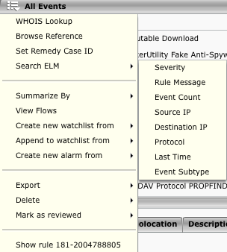
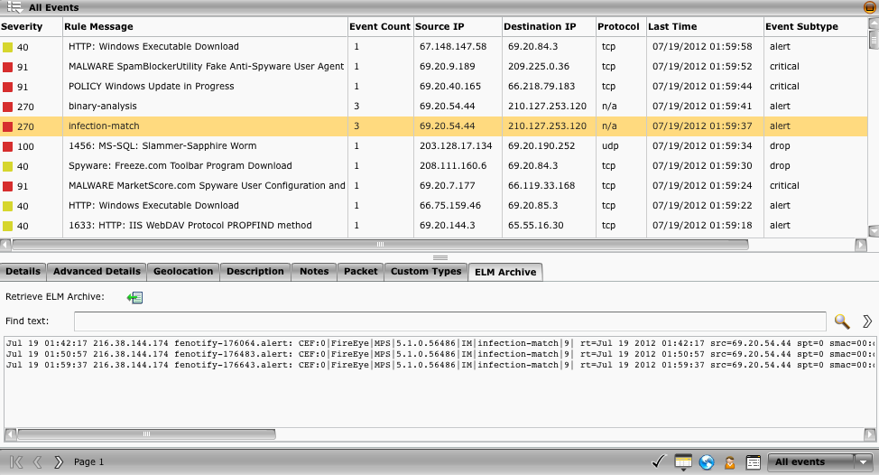
Event Analysis – Search ELM
Instantly access the RAW logs for any event for evidence extraction or further investigation into data that may not have been parsed out within the ESM event.

Slide 11
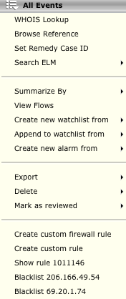
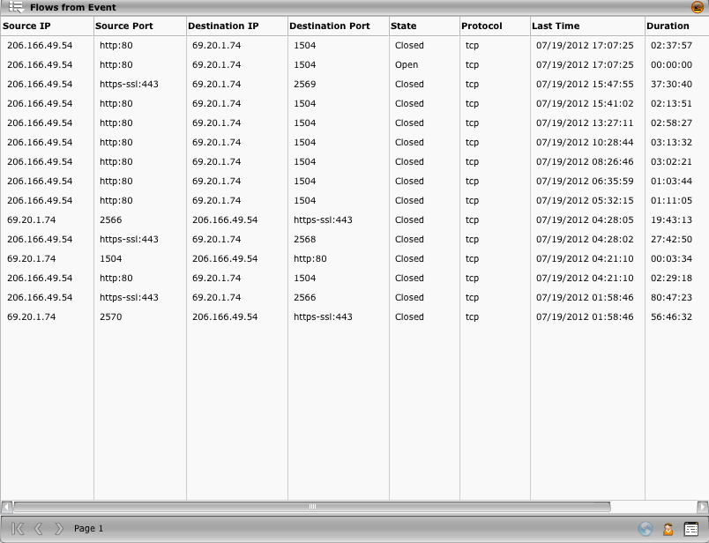
Event Analysis – Flows from Event
Instantly access all flows associated with any event.
Events tend to only represent a small subset of the overall activity associated with an incident and network flows can provide an analyst with the larger scope.

Slide 12
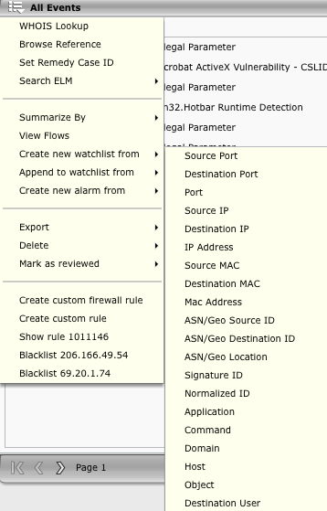
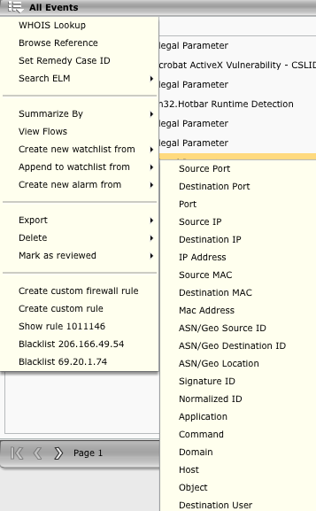
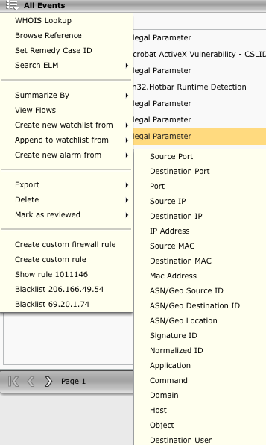
Event Analysis – Event to Watchlist or Alarm
When investigating an incident an analyst may want to track a parameter within the event for additional activity or occurrences. This can be done by simply creating a watchlist, appending to an existing watchlist, or creating an alarm.

Slide 13
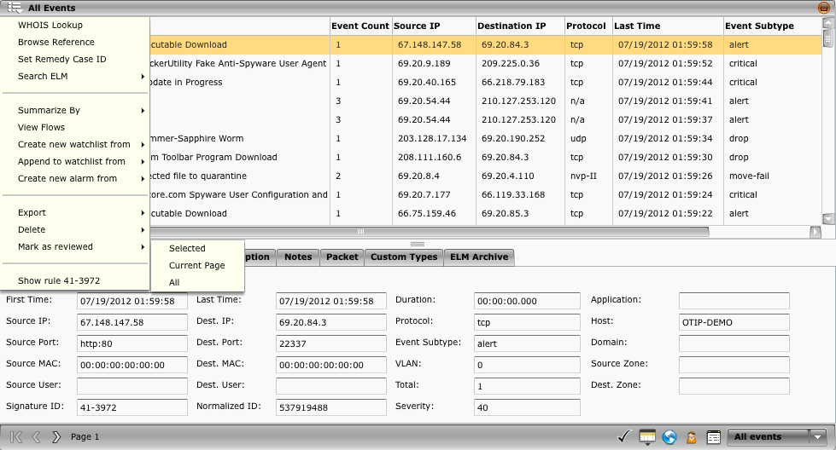
Event Analysis – Mark as Reviewed
The Event Analysis view can be used as a working dashboard for which events can be marked as reviewed to alert other analysts that an an event has been reviewed in a collaborative environment.

Slide 14
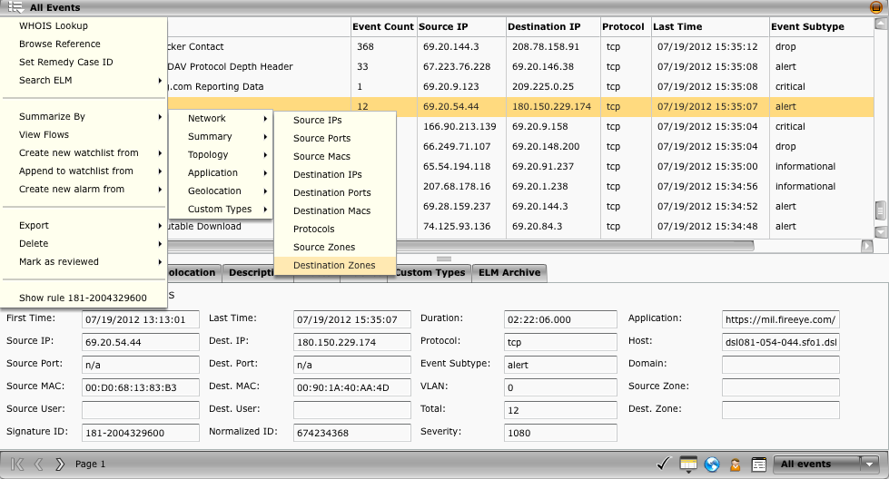
Summarize By
When an analyst needs to gain Situational Awareness by examining the bigger picture associated with an IP, User, Application, Protocol, or any other field the summarize by “drill-out” workflow provides that capability.
Notes:
This workflow is commonly referred to as going from ground zero to the 10,000ft overview to identify what else may have been occurring within the environment and is associated with the individual event of interest.

Slide 15
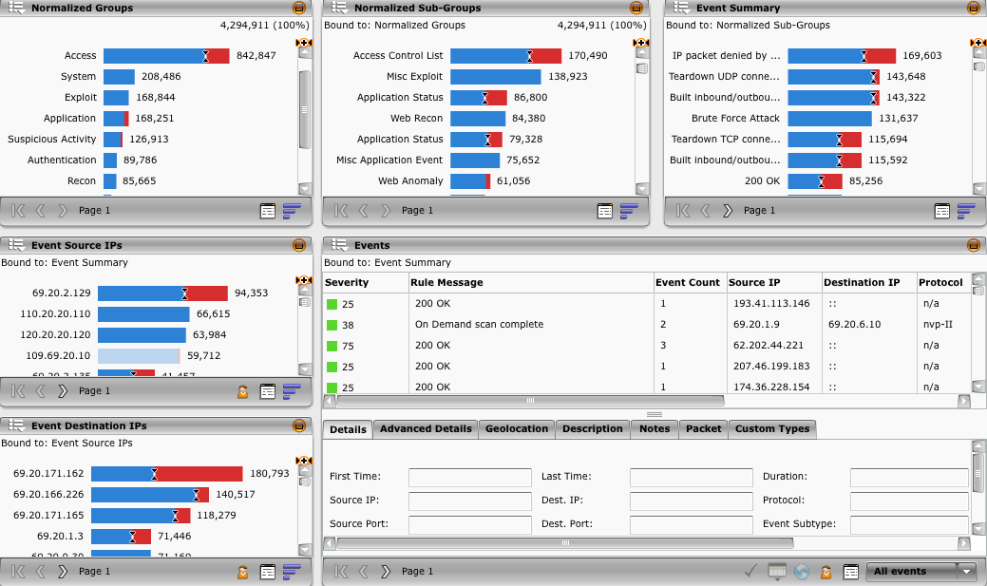
Normalized Dashboard
When an analyst needs to gain Situational Awareness by examining the bigger picture of what types of events and incidents are occurring within their environment the Normalized Dashboard is a GREAT starting point.
Notes:
The normalized dashboard allows an analyst to examine the entire environment in a categorized fashion with anomaly detection built into each component. If an analyst wants to investigate a particular category each component is data-bond to the previous component making it extremely efficient for drilling down into events of interest.

Slide 16
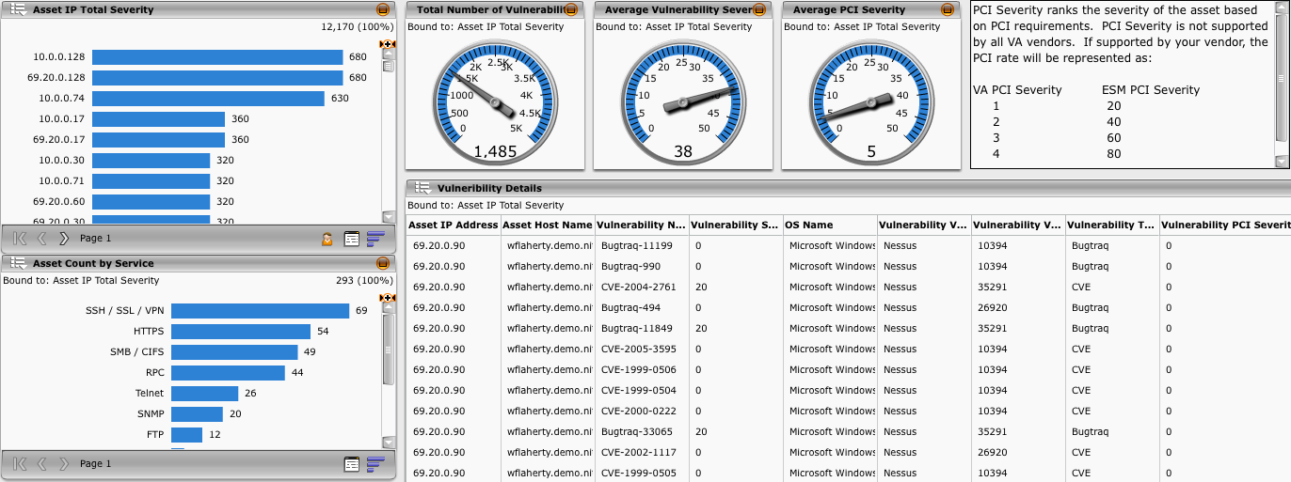
Asset Vulnerability Summary
The asset summary vulnerability summary dashboard provides an accurate overview of the current asset vulnerability state. An analyst can from this dashboard pivot out from vulnerability data into both event data and network flows to understand how each vulnerable system is being utilized within the environment.

Slide 17
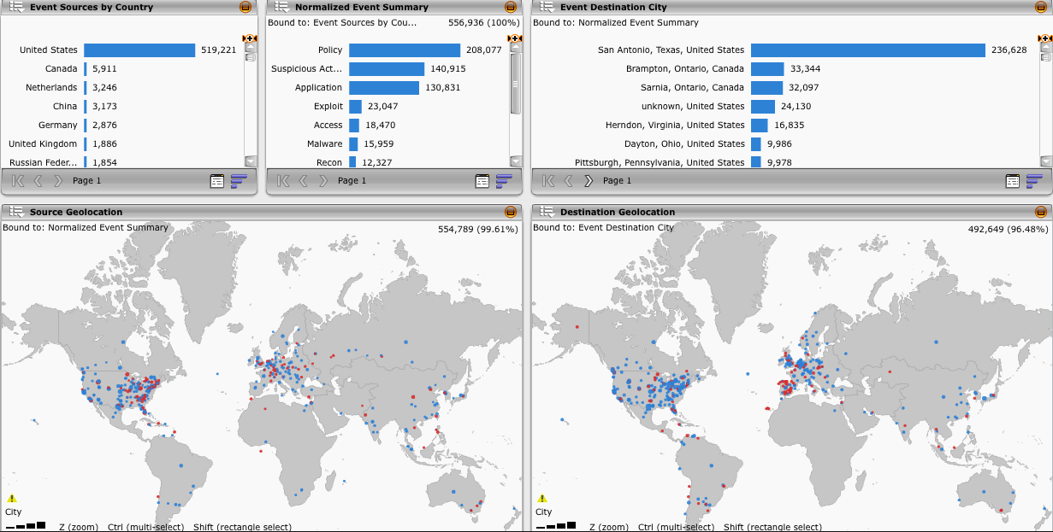
Event and Destination Geolocation
The Event and Destination Geolocation view provides an analyst with a holistic view into where events are originating and terminating geographically. The geographical maps can be zoomed in to highlight a specific area all the way down to the zip code. This data can also be pivoted on to show associated events and network flows.

Slide 18
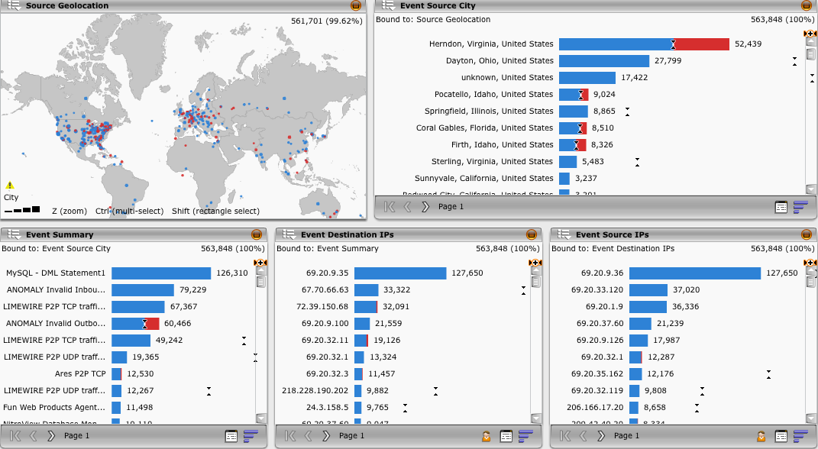
Geolocation Map
The Geolocation Map view provides a geographical representation of where events are originating, the types of events that are occurring, and the IPs associated with these events. Each component is data-bond to the previous to allow for seamless filtering in a single view.

Slide 19
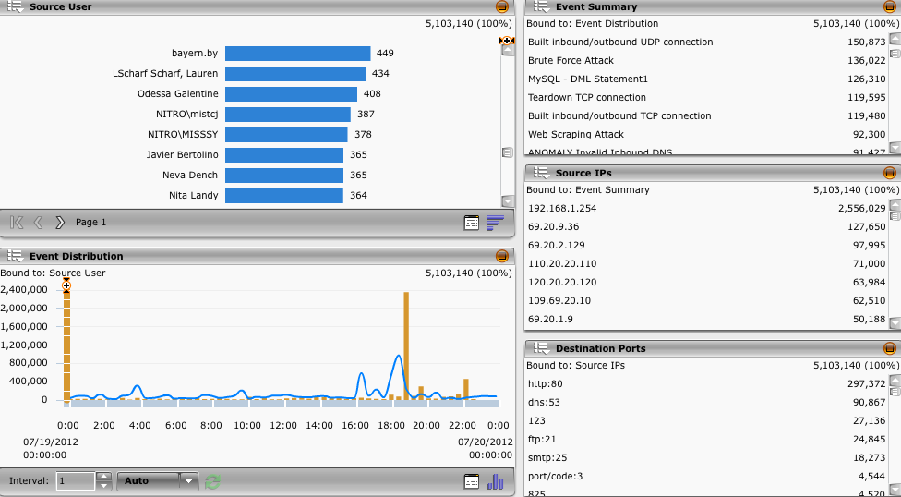
Source User Summary
The Source User Summary view provides an analyst with a starting point to track and monitor user activity within their environment.

Slide 20
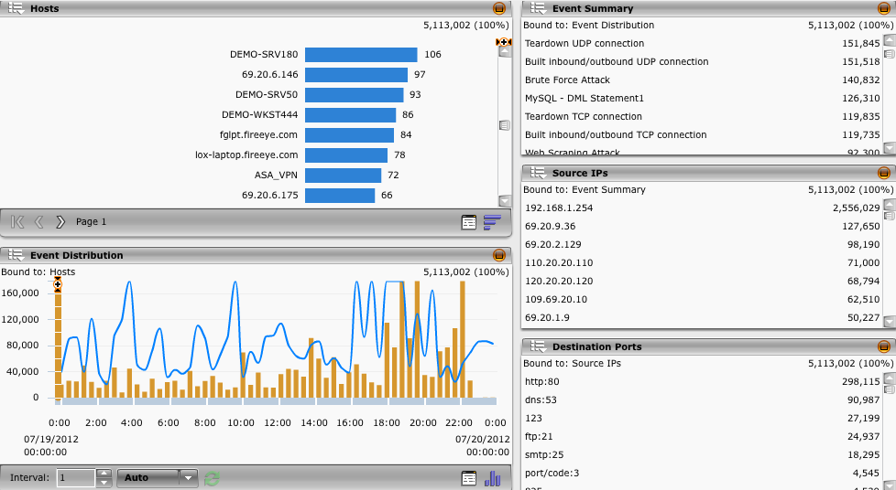
Host Summary
The Host Summary view provides an analyst with a starting point to track and monitor host activity within their environment.

Slide 21
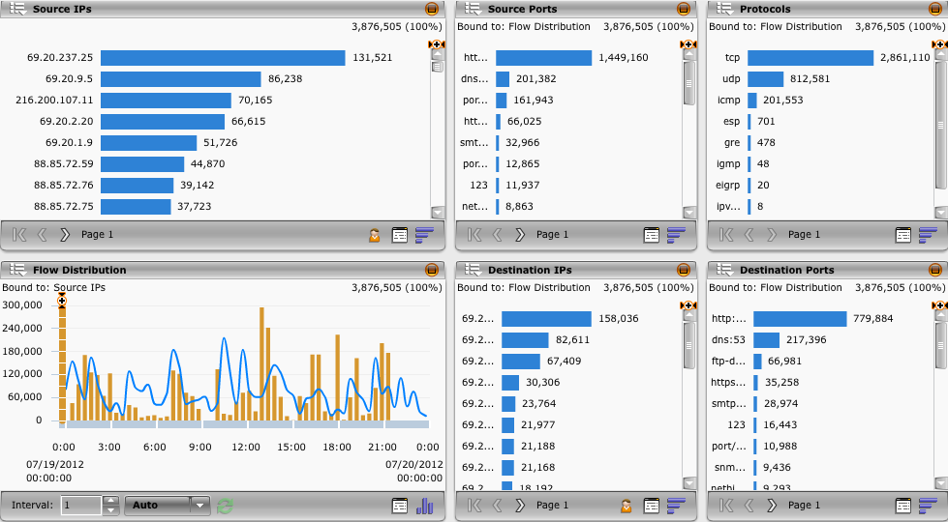
Default Flow Summary
The default flow summary is an ideal starting point for gaining insight into what network protocols are flowing across that network and where that traffic originated and terminated.
Notes:
From any flow view an analyst can pivot back into event details using the drill down menu options to show events associated with any flows selected.

Slide 22
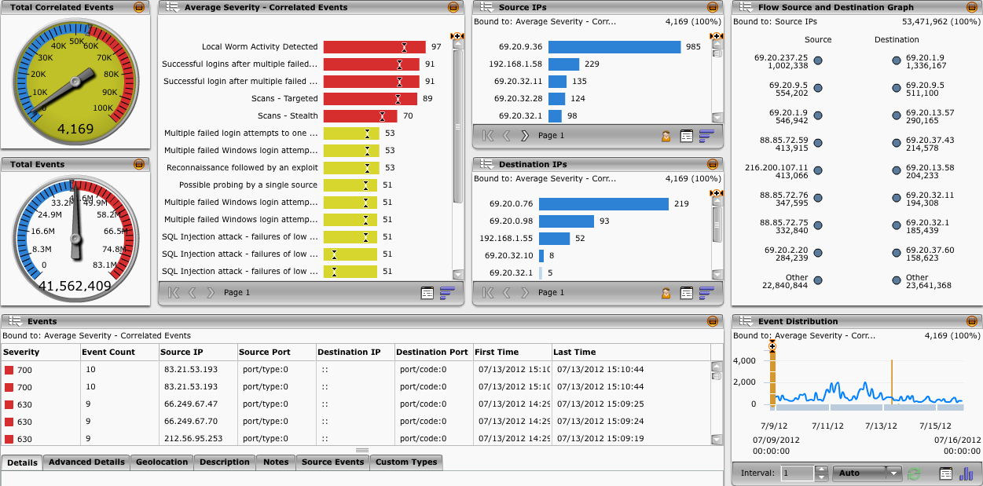
Incident Dashboard
The Incident Dashboard provides what is critical and what is important to the analyst by displaying correlated events by average severity.

Slide 23
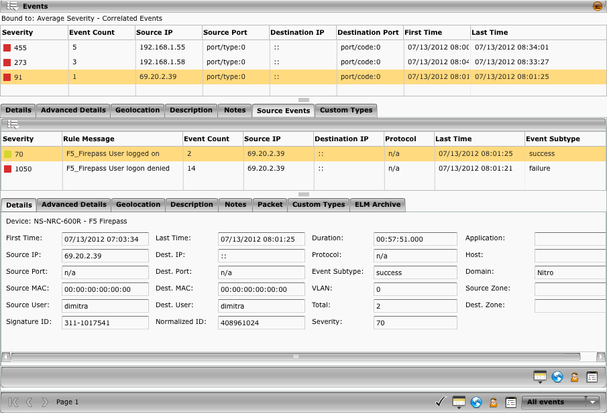
Incident Dashboard – Event Drilldown
Within the Incident Dashboard, the event analysis view component can be expanded to drilldown into the source events that resulted in a correlated incident. From here, a case, alarm, watchlist, or blacklist can be created with a single click.

Slide 24
SIEM Workflow Demonstration
Scenario:
Jimmy Detectall is a security analyst for Hangers-R-Us and is investigating weak password violations when he stumbles across an additional alert within his SIEM titled “large file transfer”. Upon further investigation into the alert and comparing the event with flow traffic Jimmy uncovers a slow and low data exfiltration attack. This data exfiltration occurs every night at 1 am and is sending encrypted data over port 80 to a Chinese IP address.

Slide 25
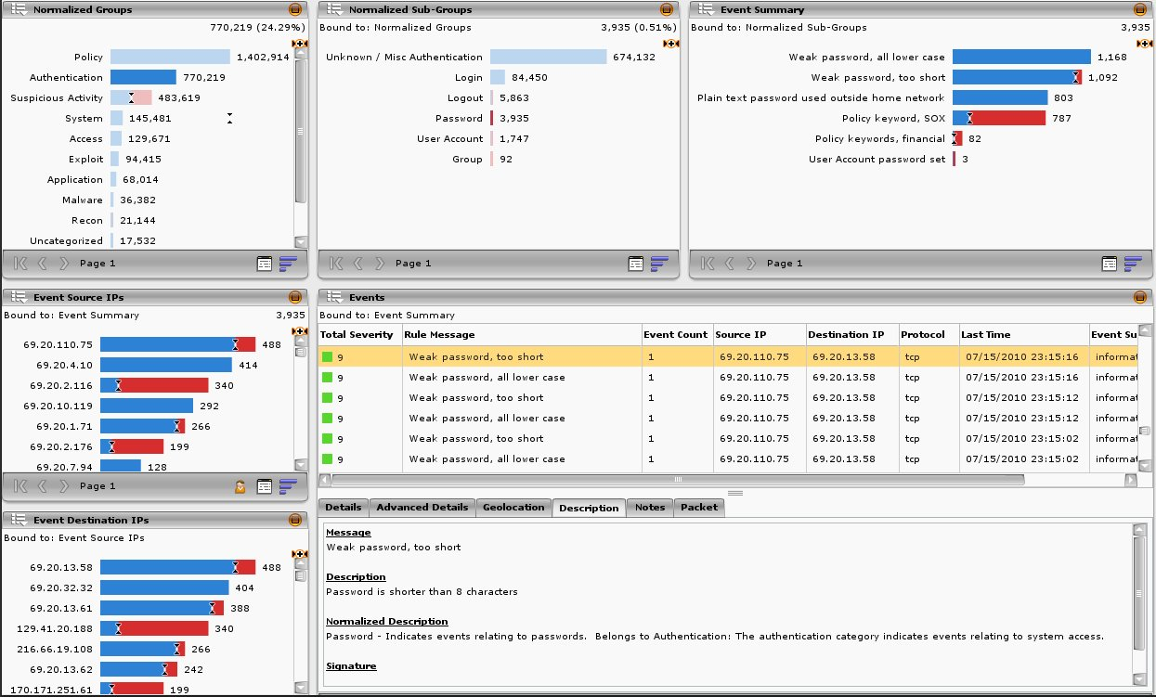
Identify Slow and Low Data Exfiltration
Weak Passwords Policy Violations
Normalized
Notes:
Jimmy starts his analysis at the Normalized Dashboard, as he can easily filter within the window for all authentication events that are password related.

Slide 26
Identify Slow and Low Data Exfiltration
Weak Passwords Top Offender
Notes:
After filtering the Normalized Dashboard for all password related events, Jimmy starts his analysis by identifying the top offender.

Slide 27
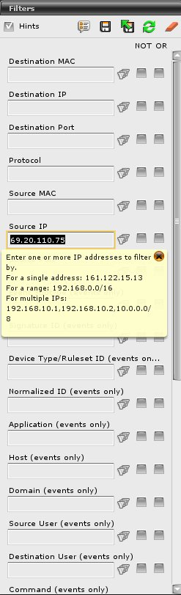
Identify Slow and Low Data Exfiltration
Investigate Top Offender
Notes:
Once the top offender has been identified, he uses a filter to search for all activity associated with this Source IP.

Slide 28
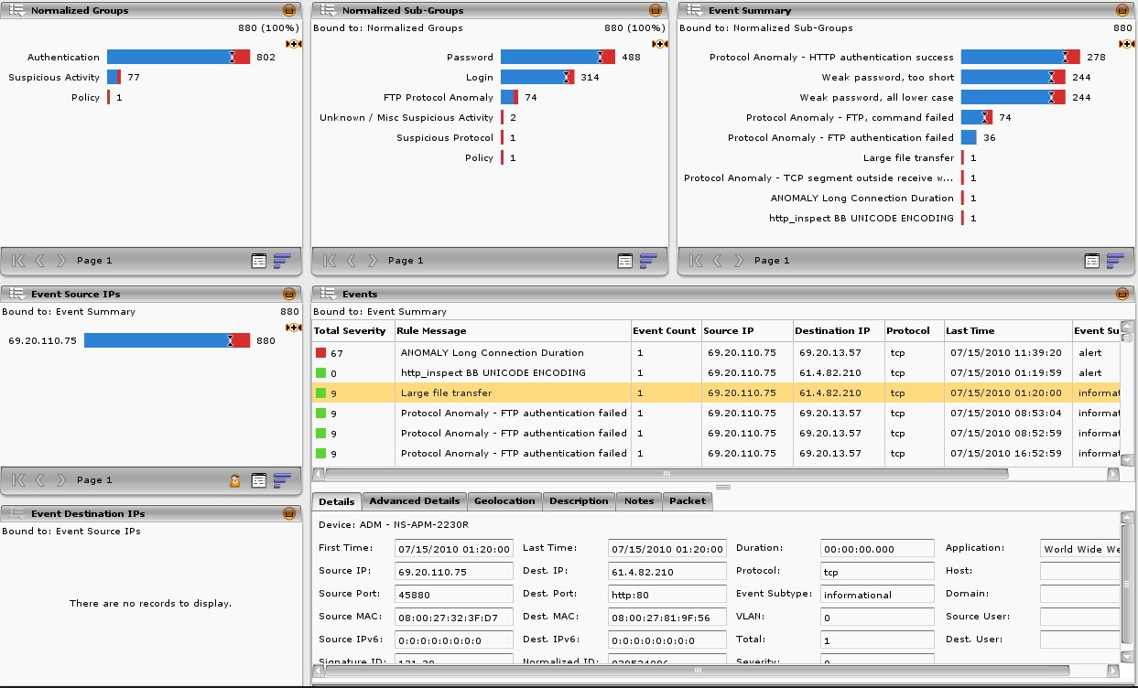
Identify Slow and Low Data Exfiltration
Associated Events Filtered by IP
Normalized
Notes:
Johnny exams the results and notices multiple protocol and protocol anomalies associated with this Source IP.

Slide 29
Identify Slow and Low Data Exfiltration
Interesting Events Large File Transfer
Associated Events Filtered by IP
Normalized
Notes:
What stands out most to Johnny is a large file transfer alert.

Slide 30
Identify Slow and Low Data Exfiltration
Investigate Event Large File Transfer
Notes:
Johnny selects the large file transfer event message to filter the event analysis view to get the details regarding this event.

Slide 31
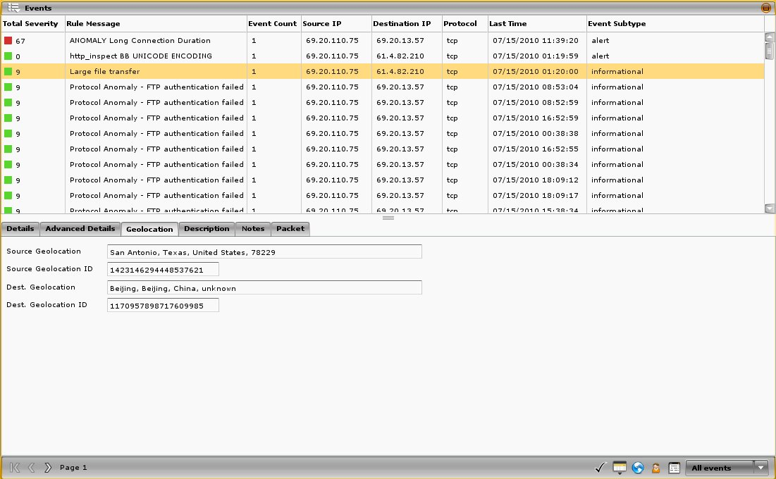
Identify Slow and Low Data Exfiltration
Geo-IP Large File Transfer to China
Notes:
Examining the details, Johnny realizes the large file transfer was to a Chinese destination host in Beijing China.

Slide 32
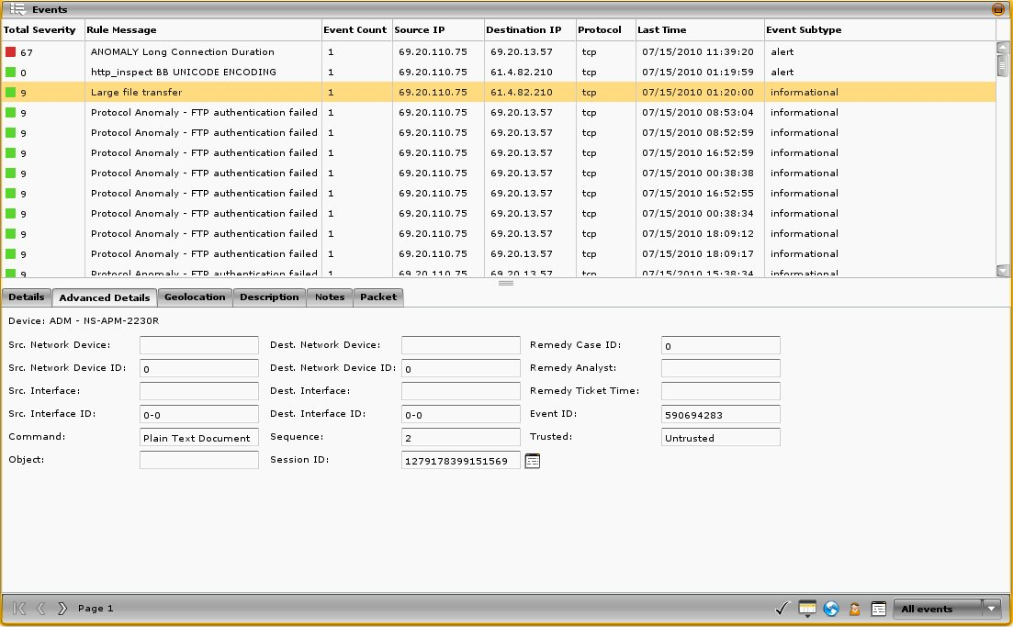
Identify Slow and Low Data Exfiltration
Advanced Details Large File Transfer to China
Session Details
Notes:
Concerned with the destination location, Johnny examines the actual session details for this ADM event.

Slide 33
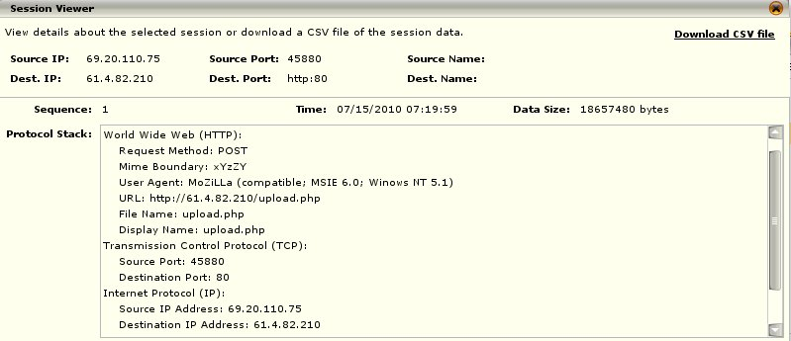
Identify Slow and Low Data Exfiltration
HTTP POST
Bytes Transferred
Misspelled User Agent
Advanced Details Large File Transfer to China
Session Details
File Name
URL
Notes:
Johnny grows extremely concerned when he learns the data was ex-filtrated via an HTTP POST to a URL containing an IP address and a misspelled User Agent. Johnny has seen this type of activity before and knows it normally means the box has a data stealing Trojan installed on it, or is at least compromised.

Slide 34
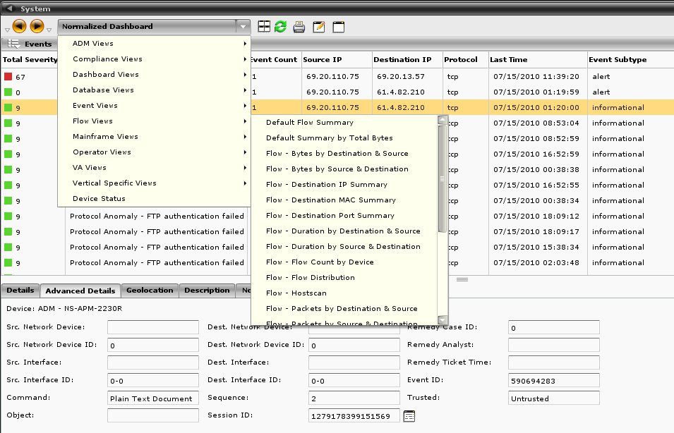
Identify Slow and Low Data Exfiltration
Pivoting Events and Flows
Filter Still Applied
Notes:
Johnny knows that event data only tells part of the story and wants to get a better idea of what else this compromised host has been doing, so he decides to pivot the event data into network flow data.

Slide 35
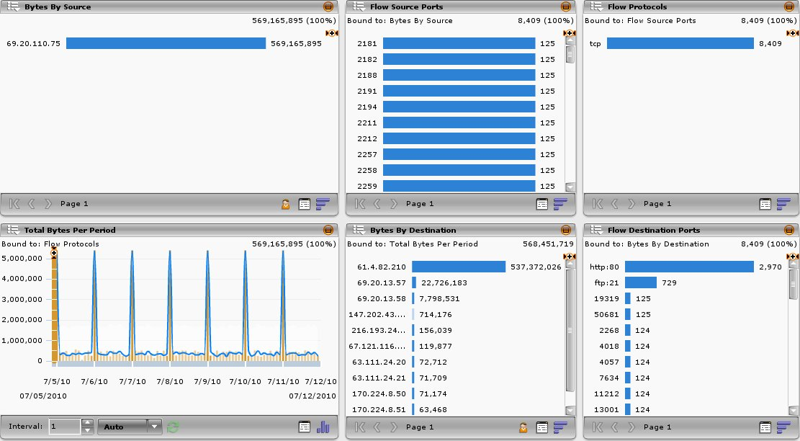
Identify Slow and Low Data Exfiltration
Flows Summary by Total Bytes
Bytes Transferred to China
Flows Summary by Total Bytes
Pattern: Every Night At
1:00 AM
Notes:
Johnny quickly identifies a large set of data exfiltration to the Chinese IP address, that occurs every night at midnight and passes this information off to the incident response team for clean up and mitigation.

Slide 36
Identify Slow and Low Data Exfiltration
Key take-aways from this demonstration
Compliance and policy violations can uncover higher severity incidents
Normalization provides a quick operational overview for an analyst
Content awareness adds to the forensic capabilities of SIEM
Geo-IP can provide context
Events combined with flows can tell the whole story
Flow distribution patterns can uncover covert channels
SIEM provided these actionable items for this scenario:
Antivirus missed Trojan: Maybe we should update our virus definitions?
Misspelled User Agent: Perfect for IDS/IPS signature
Password policies need enforced
Firewall mitigation to block China IP address
Scoped the entire event to include time frame and supporting events

Slide 37
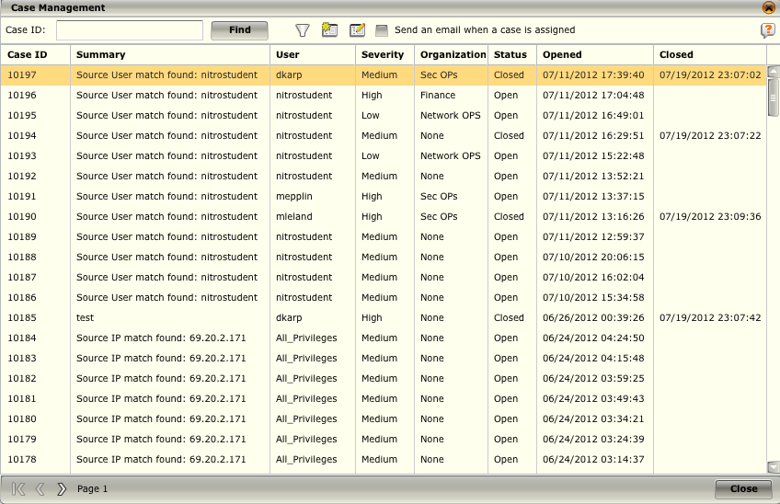
Case Management
The Case Manager is an easy-to-use feature that allows you to assign and track work items and support tickets associated with network events.

Slide 38
Case Management
Case Management has the following characteristics:
Cases can be assigned to a group of users.
Cases can be set to email the case to the person or group to whom it is assigned.
Case can be emailed to any address you designate.
Events can be added to a case by selecting them on an event view
Event data can be viewed from the Case Details screen.
Cases do not have to be linked to an event.
Cases are given a unique, system-generated case number.
Cases can be assigned to an organization and/or one or more users on the ESM
Cases can have one of two status states: open and closed (default = Open).
Cases have a creation time stamp as well as a closed time stamp.
Severity can be assigned to a case. (low, medium, and high) (default = Low).
Each case has a notes section where comments are saved and maintained.
All open cases can be viewed on the Open Case Management screen
Case management reports can be generated

Slide 39
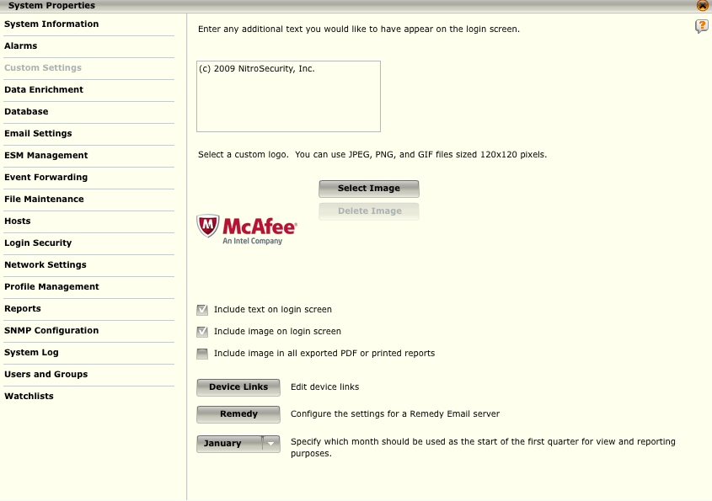
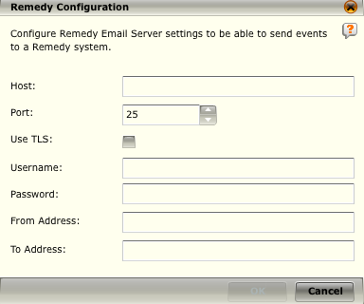
Remedy Interface
The Remedy Configuration dialog allows you to configure the remedy settings so the ESM can communicate with a remedy system.
Notes:
Remedy Email Server Settings
1. Access the System Properties screen.
2. Click on the Custom Settings option. The Custom Settings screen opens.
3. Click on the Remedy button. The Remedy Configuration dialog opens.
4. Enter the host and port for the Remedy system; whether or not you want to use TLS (an encryption protocol); the username and password, if required; the email address of the remedy message sender; and the email address to which the remedy message should be sent.
5. Click OK. When you select the Remedy option on the Event Analysis View, the email will be populated with the information that you entered in this dialog.

Slide 40
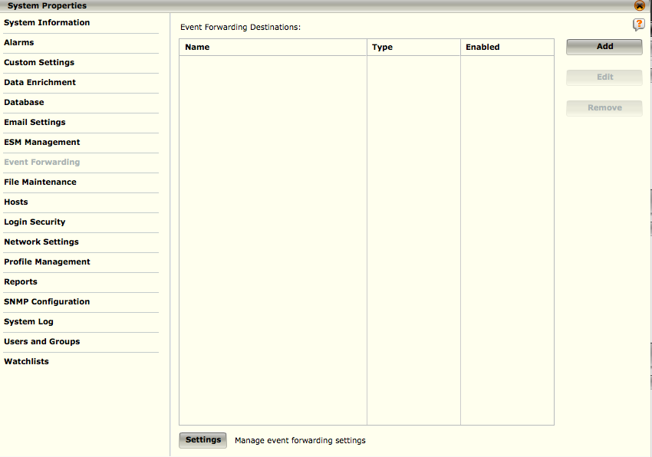
Event Forwarding
The Event Forwarding screen allows you to configure the forwarding of event data to a syslog or SNMP server.
An event forwarding destination can be added, modified, and deleted depending on what the user would like to perform with the incoming event data.
Notes:
To access Event Forwarding:
1. Select the System node in the System Navigation Tree.
2. Select the the Properties icon in the Actions Toolbar. The System Properties dialog will open.
3. Click on the Event Forwarding option. The Event Forwarding screen opens.

Slide 41
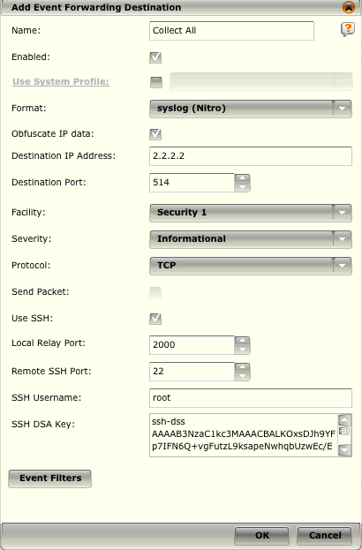
Event Forwarding - Adding an Event
Use System Profiles – Allows you to use pre-defined settings for commonly used ESM.
Event Forwarding Agent – This defines the formats, including the fields contained within the forwarded event.
Name – A name for the Event Forwarding settings.
Destination IP Address / Port – The IP address and the port where the event is to be sent.
Facility / Severity / Protocol – Options for the syslog protocol.
Send Packet – If you have your policy set to copy a packet, selecting the Send Packet option will forward the packet information.
SSH - If you choose to use syslog over TCP, you have the option of making the TCP connection over an SSH tunnel.
Event Filters - Event filters allow you to filter the event data that is forwarded to a syslog or SNMP server on the ESM

Slide 42
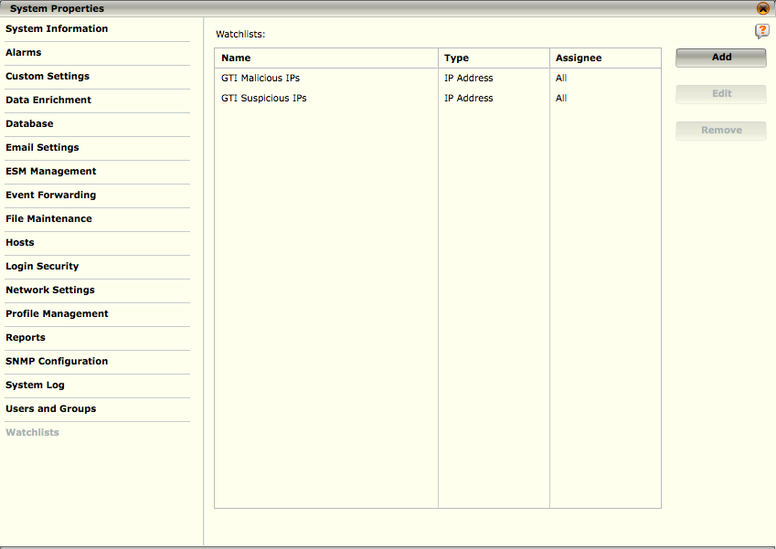
Watchlist
A watchlist is a grouping of specific types of information that can be used as filters or as an alarm condition so you will be notified when they occur in an event. They can be global or specific to a user or group and can be static or dynamic

Slide 43
Watchlist
A static watchlist consists of specific values that you enter
A dynamic watchlist consists of values that result from regular expression or string search criteria that you define
You can create a watchlist three different ways:
Using the Add a Watchlist dialog
Selecting events on a view and using the Create new watchlist from option on the view's menu
Selecting rules on the Policy Editor and using the Create new watchlist option on the Operations menu.
You can edit or delete as well as append values to an existing watchlist.
A user with administrator privileges can assign a watchlist to anyone or any group on the system. If you do not have administrator privileges, you can only assign watchlists to yourself and groups of which you are a member.
Maximum number of values is 10,000. If you import a file containing more than 10,000 lines, you will not be allowed to create the watchlist.

Slide 44
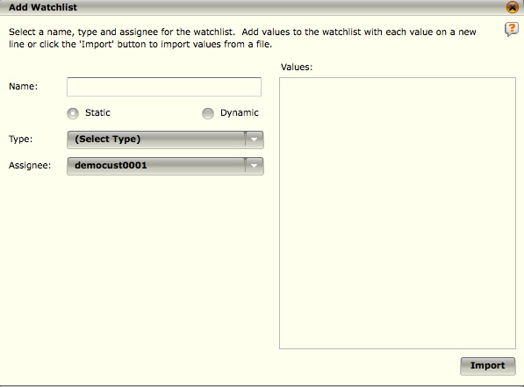
Static Watchlist
Name – Name for the watchlist
Type – The type of values contained in the watchlist.
Assignee – Select the assignee
All – Creates a global watchlist
Group – Assigns the watchlist to the group
Individual – the person the watchlist is assigned to
Import – You can import a list of values (new line separated)
You can also enter values in manually.
Once the watchlist is populated, you can create an alarm from the dialogue.

Slide 45
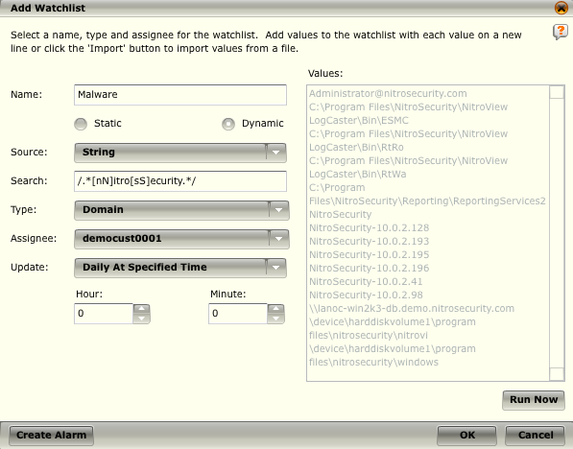
Dynamic Watchlist
Select the source against which the search should be run:
The StringMap table
The rules table
Enter the regular expression or string search criteria in the Search field
Select the type of data this watchlist will be watching for by clicking on the down arrow in the Type field
Select the frequency with which the search should be performed.
The existing values list will be replaced every time the search is run
Run the query and results will populate the Values box

Slide 46
GTI Watchlist
Global Threat Intelligence (GTI) watchlists contain more than 130 million suspicious and malicious IP addresses, with their severities, gathered by McAfee.
These watchlists can be used to trigger alarms, to filter data in reports and views, as a filter in rule correlation, and as a scoring source for a Risk Correlation Manager on an ACE.
To add the data from the lists to your system, you must purchase a GTI license from McAfee.
Once you have purchased the license, the lists will be added to your system the next time you download rules.
This process can take several hours due to the size of the database.
These lists cannot be viewed or edited.

Slide 47
You can only access RAW data from the ELM search interface and have to copy and paste filters from event views.
True
False
Notes:
Answer: False

Slide 48
The Incidents dashboard filters what kinds of events of interest?
Normalized
Assets
Flows
Correlated
Vulnerability Scan Results
Notes:
Answer: Correlated

Slide 49
Cases can only be emailed to users or groups maintained within the McAfee ESM?
True
False
Notes:
Answer: False – Case can be emailed to any valid email address.

Slide 50
The maximum number of items in a watch list is _____________ ?
1,000
10,000
100,000
1,000,000
Notes:
Answer: 10,000

Slide 51
Hands-on Practice Refer to the Practice Manual Practice 9: Workflow

